Slide 1
Multiple Plots in Matplotlib
A Deep Dive into Multi-Plot Visualization in Python
Theresha Miller
CTEC 298
Jesse Bemley

Slide 2
What Are Multiple Plots?
Multiple plots allow you to display several graphs in a single figure using Matplotlib.
They help compare datasets, visualize relationships, and display grouped information clearly.
  Types include: subplots, overlays, and grid layouts

Slide 3
Why Use Multiple Plots?
Multiple plots are useful when:
  You need to compare trends across datasets
  You want to visualize different variables over the same time period
  You want to highlight differences or relationships between data groups
  You need organized visuals for reports and presentations

Slide 4
When Would These Plots Be Used?
Common real-world examples include:
  Scientific research comparisons
  Machine learning model evaluation
  Business analytics dashboards
  Time series analysis for finance or operations
  Displaying sensor data or engineering measurements

Slide 5
Python Code
!pip install matplotlib
import numpy as npimport matplotlib.pyplot as plt
def f(t): return np.exp(-t)*np.cos(2*np.pi*t)
t1 = np.arange(0.0, 5.0, 0.1)t2 = np.arange(0.0, 5.0, 0.02)
plt.subplot(211)plt.plot(t1, f(t1), 'bo', t2, f(t2))
plt.subplot(212)
plt.plot(t2, np.cos(2*np.pi*t2))
plt.show()

Slide 6
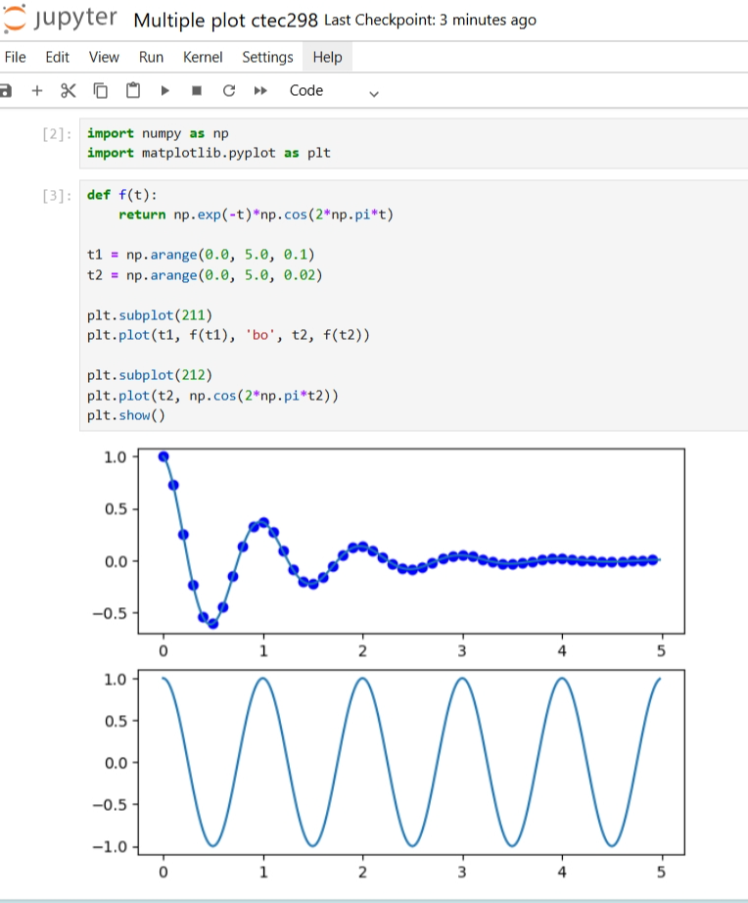
Multiple Plots Graphic

Slide 7
References
Sources:
  Matplotlib Development Team. (2025). Matplotlib Documentation. https://matplotlib.org/
  VanderPlas, J. (2016). Python Data Science Handbook. O’Reilly Media. (Chapter on visualization with Matplotlib)
  NumPy Official Documentation Harris, C. R., et al. (2020). Array programming with NumPy. Nature, 585(7825), 357–362.
  Knaflic, C. N. (2015). Storytelling With Data: A Data Visualization Guide for Business Professionals. Wiley

